Slide 1

ROS based SLAM implementation for Autonomous
navigation
By
By
Sumegh Thale (16EE1027)
Mihir Prabhu (16EE1084)
Pranjali Thakur (16EE1078)
Under the Guidance of
Mr. Pratik Kadam
Department of Electronics Engineering Ramrao Adik Institute of Technology, Nerul, Navi Mumbai

Slide 2
INTRODUCTION
The use of autonomous navigating robots is increasing in the industry.
Material handling cost can be reduced upto 30%
Various advantages like reduced accidents,less fuel consumption,reduced travel time and cost
SLAM is a technique used for generating maps for autonomous vehicles.

Slide 3
PURPOSE OF STUDY:
To discuss and demonstrate concept of autonomous navigation robots
To analyze the SLAM algorithm
To study ROS framework and to implement autonomous navigation.

Slide 4
LITERATURE SURVEY
Various methods to implement SLAM through the use of Extended Kalman filter and Rao-Blackwellized Filter. (Cherubini, A., Spindler, F. and Chaumette, F., 2014)
SLAM algorithms like CoreSLAM, Gmapping, and HectorSLAM have been evaluated. (Turnage, D.M., 2016)
The use of a kinect sensor and rviz to implement autonomous navigation on turtlebot 2. ( Omara, H.I.M.A. and Sahari, K.S.M., 2015)

Slide 5
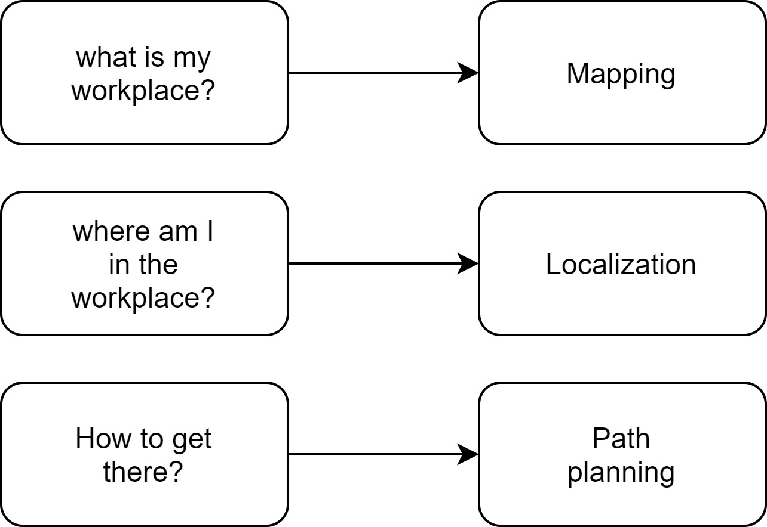
NAVIGATION ISSUES

Slide 6

WHAT IS ROS?
A software framework for programming robot.
Consists of infrastructure, tools, capabilities, and ecosystem
Free, open source, BSD license
ROS enables us to use already created packages like
Gmapping and teleop key which reduces development time.

Slide 7

TOOLS AND CAPABILITIES OF ROS
Various simulation and data visualization tools
The proposed paper uses ROS kinetic kame distribution
Gazebo and Rviz is used to simulate turtlebot

Slide 8

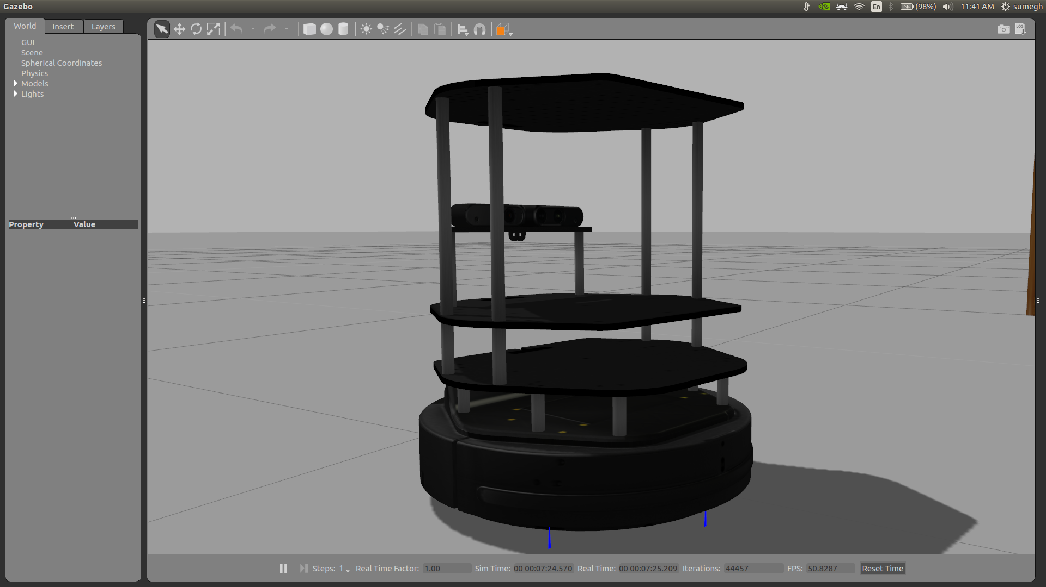
WHAT IS GAZEBO ?
3D dynamic simulator used for simulating complex robotic models in indoor and outdoor environments
It uses an physical engine for
illumination,inertia,gravity,etc.
Turtlebot in Gazebo

Slide 9
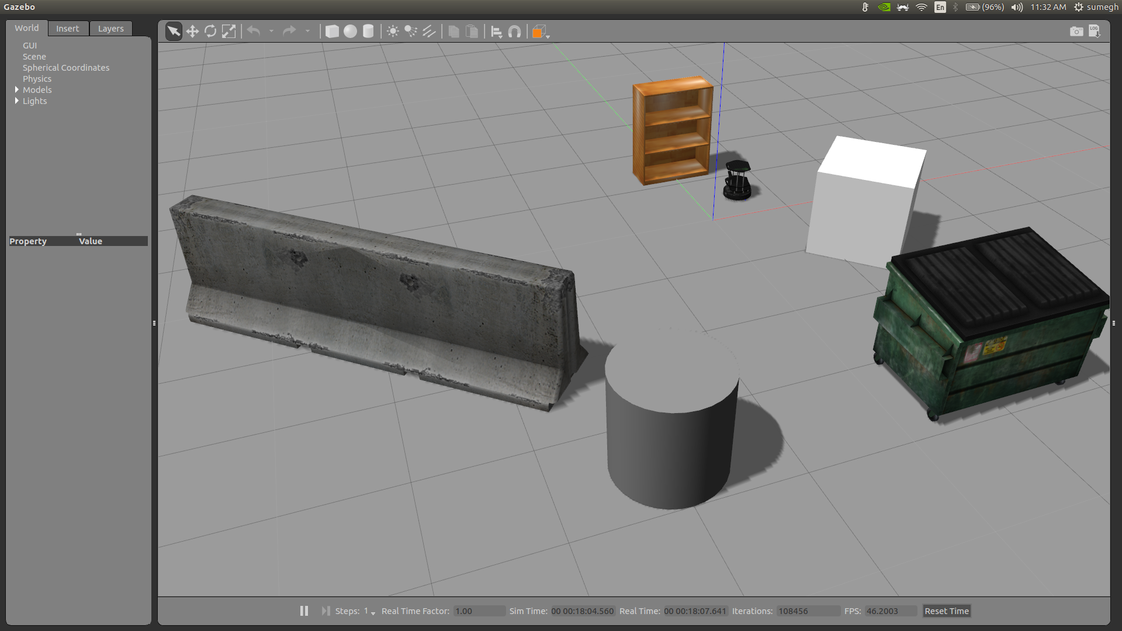
SIMULATED ENVIRONMENT IN GAZEBO
TURTLEBOT
Obstacles in the environment

Slide 10
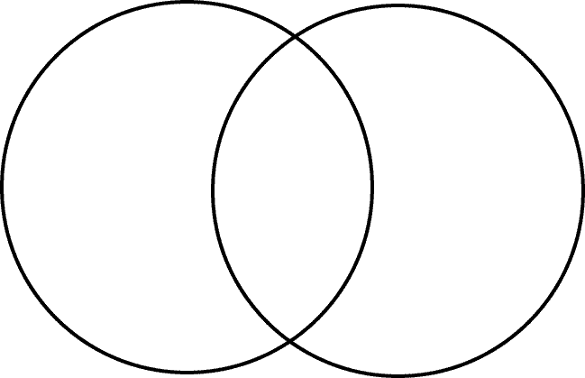
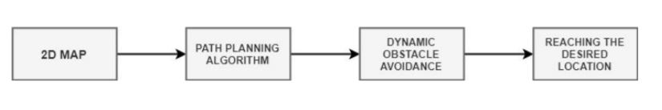
WHAT IS SLAM?
Mapping
SLAM
Localization
SLAM can be divided into two parts:
Mapping
Localization
It is used for mapping of the unknown environment.
Once the mapping of environment is performed the robot needs to navigate itself

Slide 11
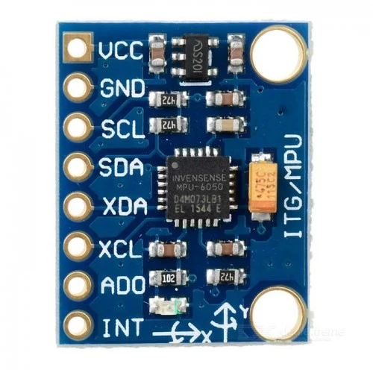
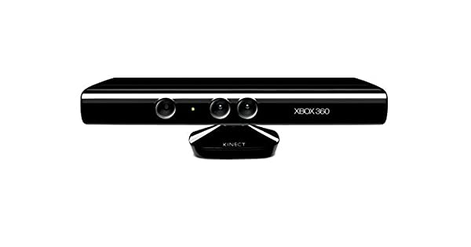
REQUIREMENTS FOR SLAM:
A Laser range finder device : Microsoft kinect
Wheel encoders for odometry data
IMU sensor
Kinect sensor

Slide 12
MAPPING
The robot needs to map the position of the objects that it encounters in the path
To map a object it takes distinct features of the object in account.
A 2D laser scan is obtained from kinect.
The robot is manually moved in the environment
The features are compared each time the robot changes its position ,thus creating a 2d map

Slide 13
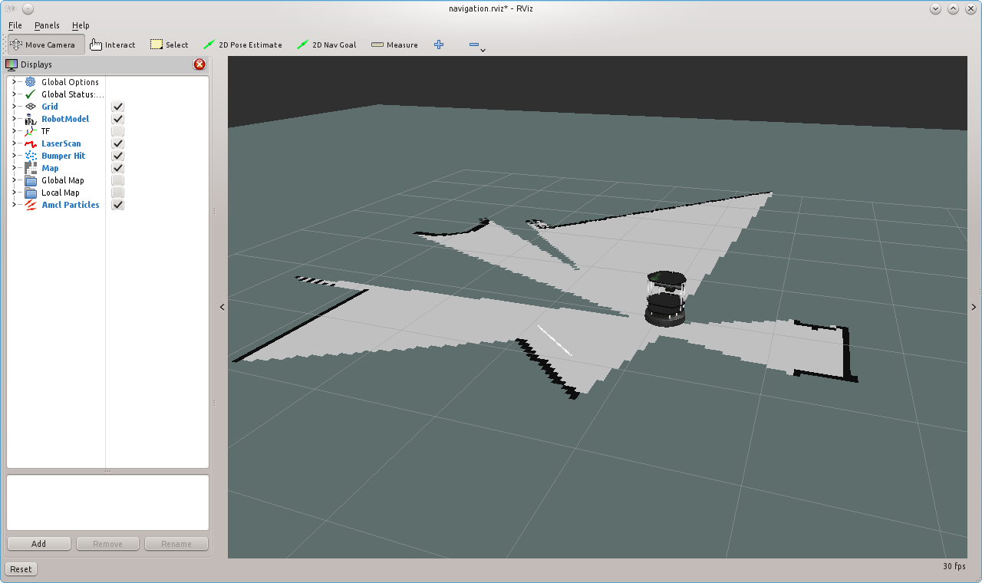
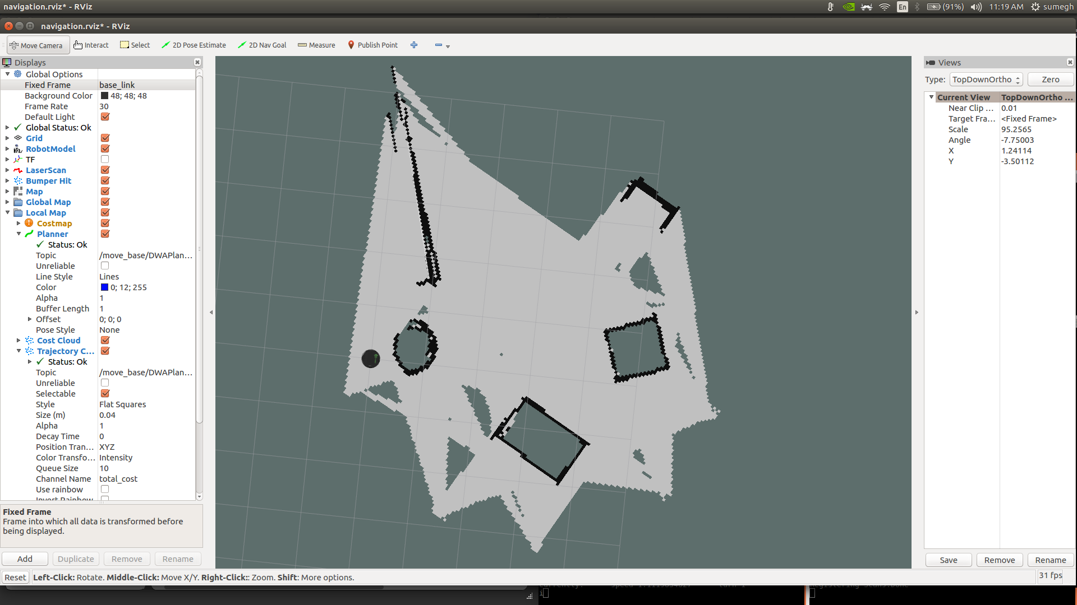
GENERATED MAP
Occupied space
Free space
Unexplored region

Slide 14
LOCALIZATION
Once mapping is done ,the robot needs to navigate itself.
Navigating this environment while keeping the track of robots relative position and its orientation is known as localization
The robot uses odometry data from kinect,IMU and encoders to approximately locate itself in the map.
A extended Kalman filter is used to remove noisy data.
Further path planning algorithms like AMCL are used for autonomous navigation
Further path planning algorithms like AMCL are used for autonomous navigation

Slide 15
AMCL(Adaptive Monte Carlo Localization )
Amcl is a probabilistic localization system for moving the robot in 2D.
It is an algorithm to localize the bot using a particle filter.
It generates random guesses of where the robot is going to be next.
A global and local planner is used for path planning .
Using 2D nav goal the robot moves towards the destination avoiding obstacles.

Slide 16
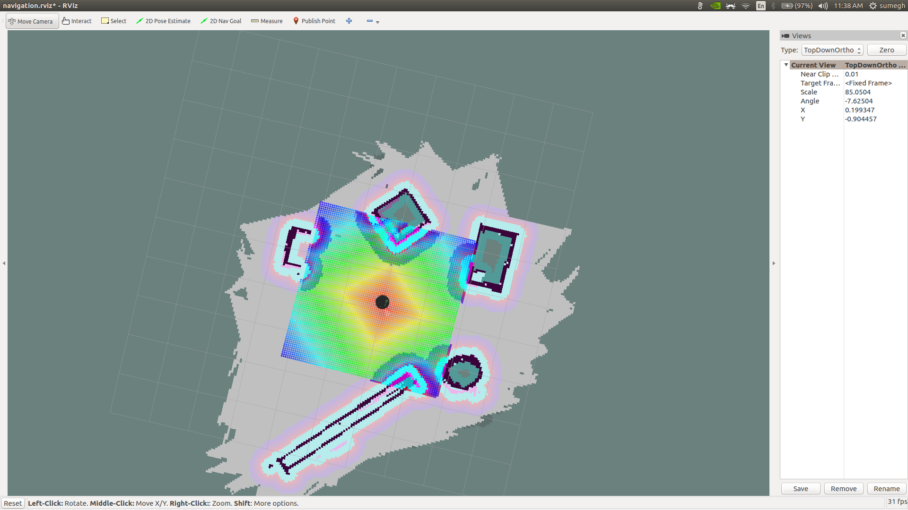
LOCALIZED TURTLEBOT
Turtlebot

Slide 17
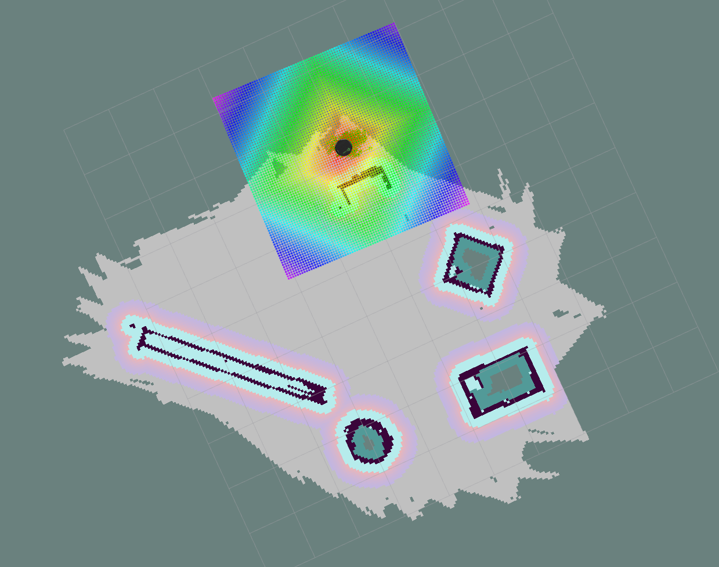
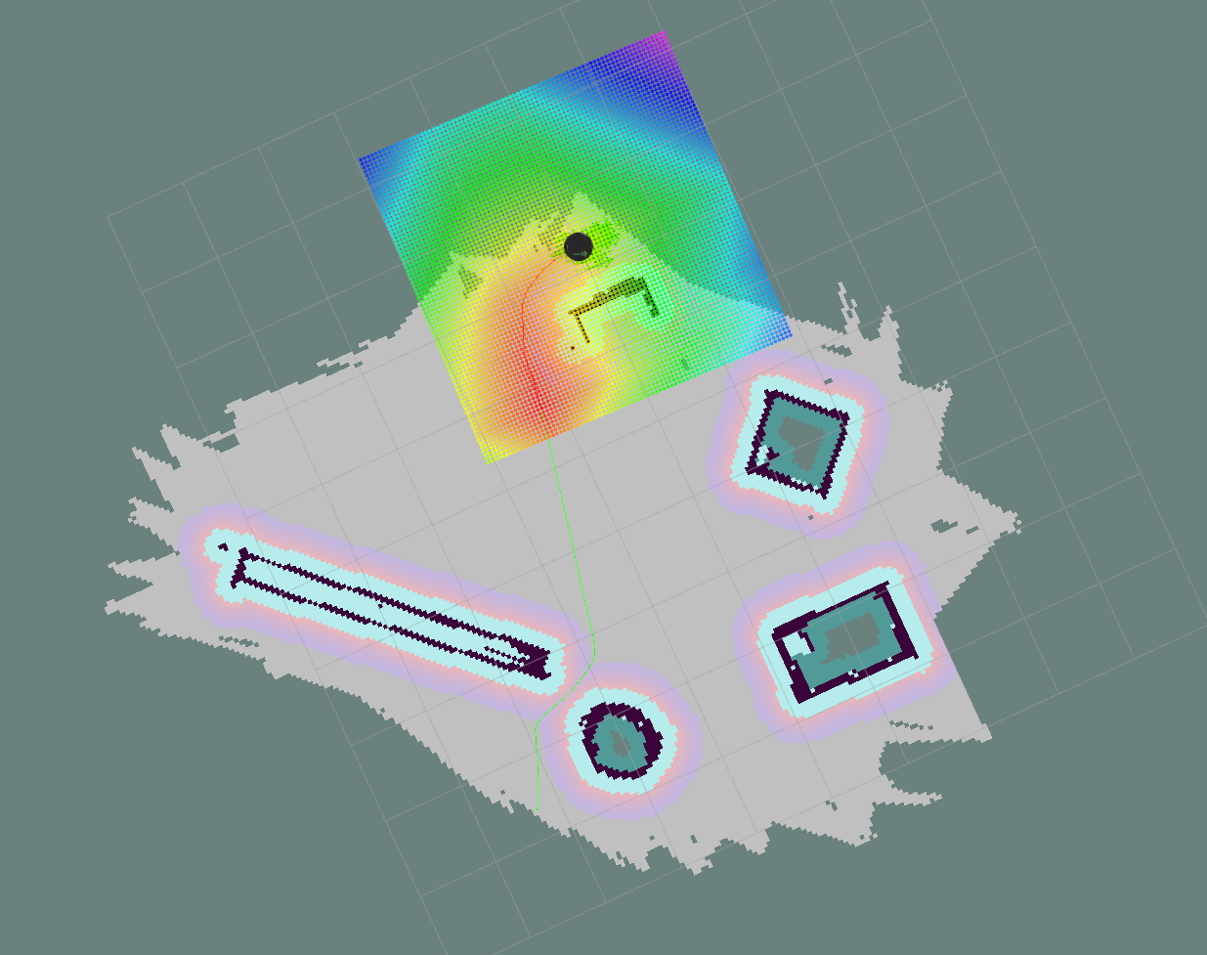
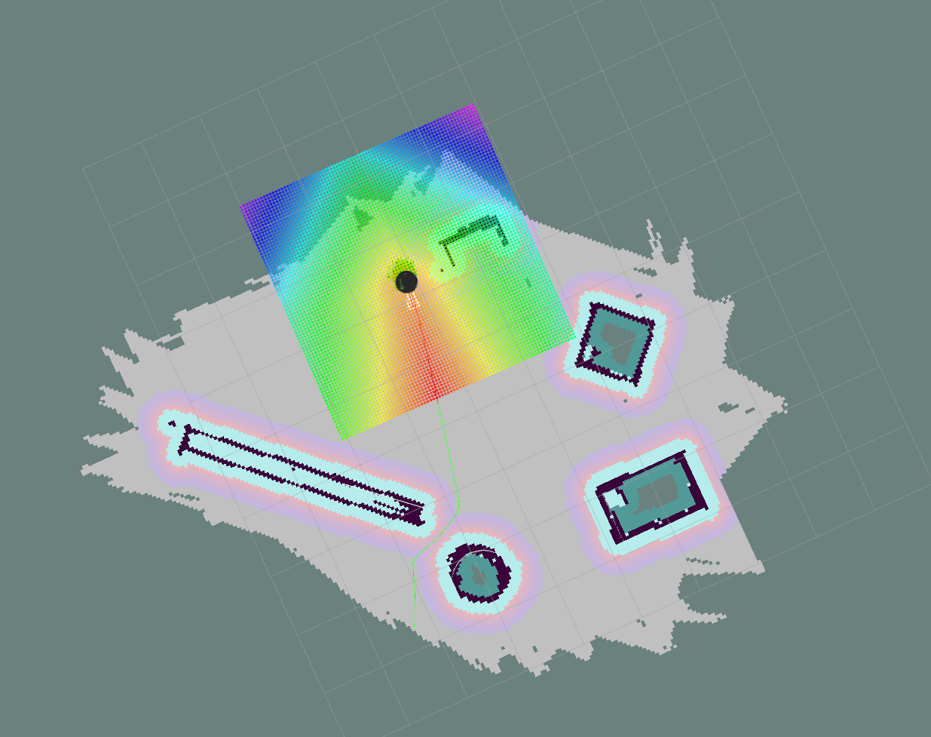
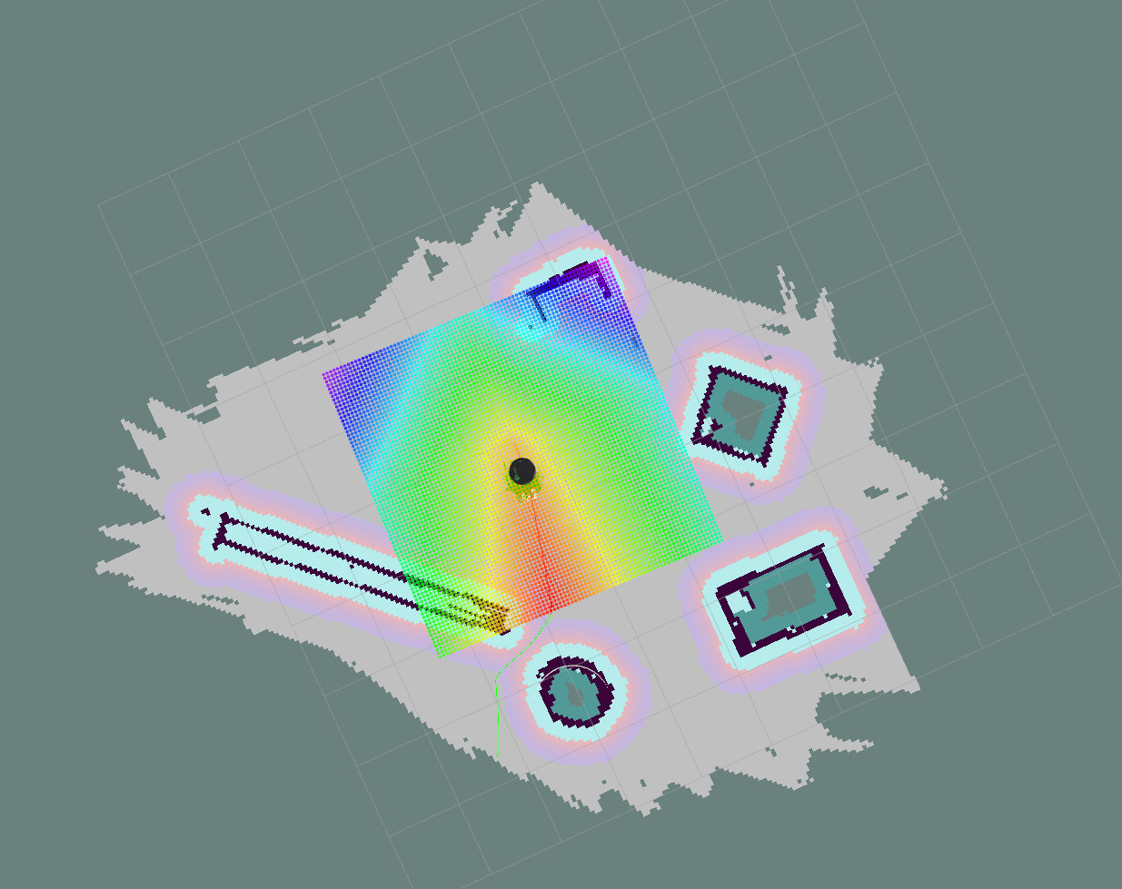
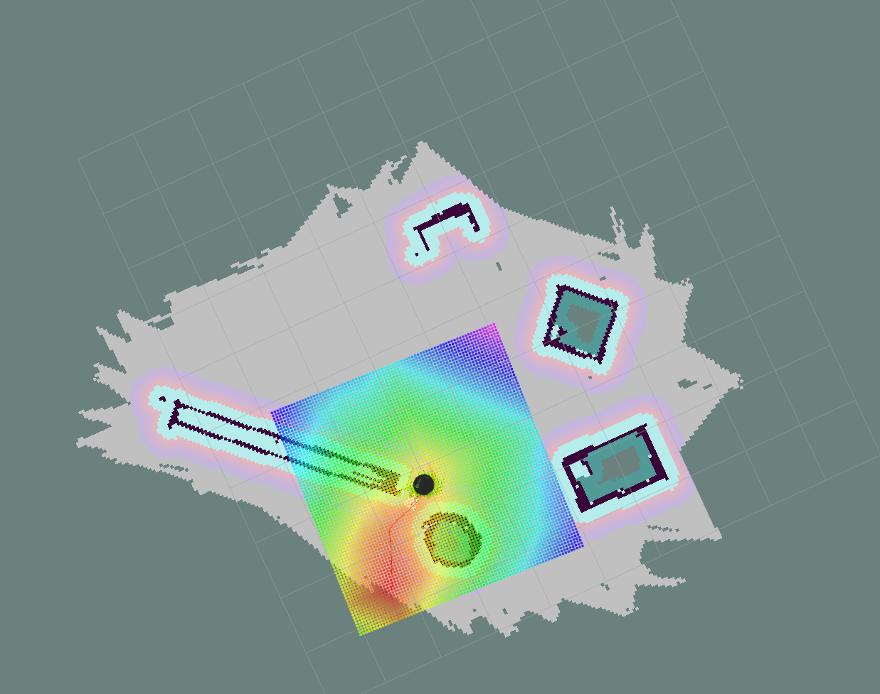
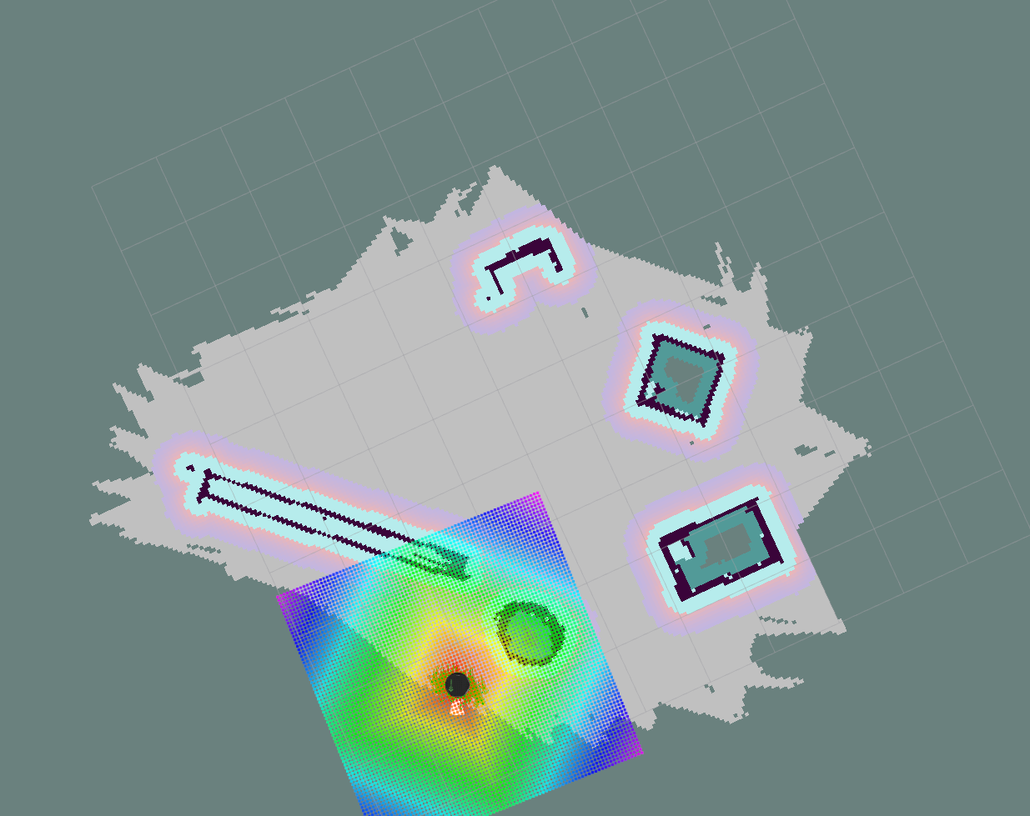
AUTONOMOUS NAVIGATION RESULTS
1.
2.
3.
Starting position
4.
5.
6.
Destination

Slide 18
Components
Motor : The motor used is 24V a DC motor which has a gearbox of 6mm diameter.
Wheels : The wheels used are 100MM MODIFIED Heavy Duty(HD) DISC Wheel Yellow comes with high-quality silicon rubber grip to give you excellent traction when needed most.
Power Supply Unit : A switched-mode power supply is an electronic power supply that incorporates a switching regulator to convert electrical power efficiently.
Motor Drivers : Motor drives are circuits used to run a motor.
Microsoft xbox 360 kinect : It provides point cloud which can be converted into 2D laser scan.
IMU : Reading the raw values for the accelerometer and gyro is easy.

Slide 19
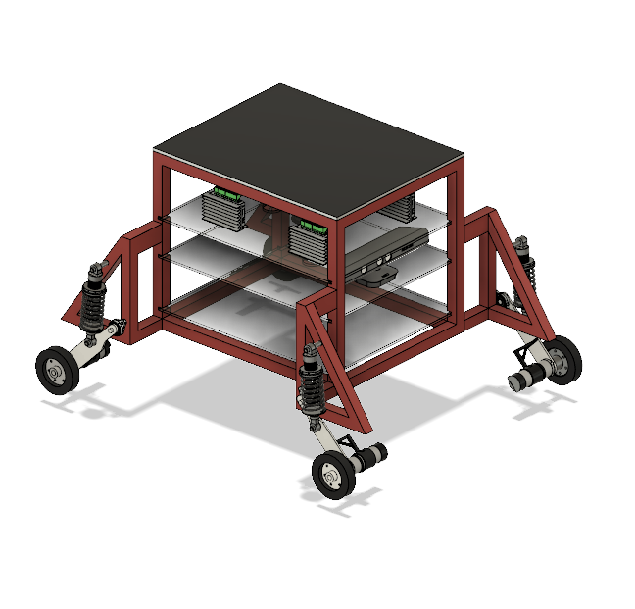
Hardware Design
Software used for design and simulation is
Autodesk Fusion 360.
Material used for fabrication of rover’s
chassis is Aluminium 6061 cold form .
Acrylic sheets are used for the placement
of electronic components.

Slide 20
Design Approach
● The chassis of mobile is made of a hollow cuboid framework of aluminum attached
with triangular fenders attached to every pillars to which the axles are connected.
● The chassis is driven by a four by four wheel drive with damping
system for terrain surfaces.
● Main purpose of using four wheel drive is to obtain better stability and
perform pivot turning.

Slide 21
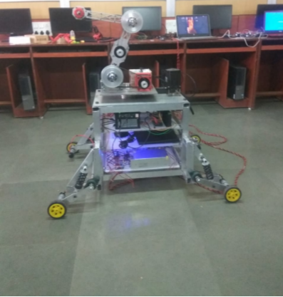
Completed Robot Hardware

Slide 22
CONCLUSION
We have analyzed and successfully simulated an autonomous navigation system using ROS.
Turtlebot was used in a simulated environment created with the help of Gazebo for experimenting and implementing autonomous navigation.
The map was successfully generated by robot and managed to reach the assigned destination without colliding.
The full hardware implementation and calibration for achieving more precision remains for future work.

Slide 23
REFERENCES
Dissanayake, Gamini and Williams, Stefan B and Durrant-Whyte, Hugh and Bailey,Tim, “Map management for efficient simultaneous localization and mapping (SLAM)”Autonomous Robots, pp. 267–286, 2002.
Araujo, Andre and Portugal, David and Couceiro, Micael S and Rocha, Rui P , “Integrating Arduino-based educational mobile robots in ROS”, Journal of Intelligent Robotic Systems, pp. 281–298, 2015.
Krinkin, Kirill and Stotskaya, Elena and Stotskiy, Yury, “Design and implementation Raspberry Pi-based omni-wheel mobile robot” 2015 Artificial Intelligence and Natural Language and Information Extraction, Social Media and Web Search FRUCT Conference (AINL-ISMW FRUCT), pp. 39–45, 2015.
Hasan, HM and Mohammed, TH,“Implementation of Mobile Robot’s Navigation using SLAM based on Cloud Computing”, Engineering and Technology Journal, 2017, 1, pp. 634–639.
Murray, Peter and Schukat, Michael, “MAV based SLAM and autonomous navigation: A view towards efficient on-board systems ”, 2017 28th Irish Signals and Systems Conference (ISSC), pp. 1–6, Feb. 2017.
Wang, Chieh-Chih and Thorpe, Chuck, “Simultaneous localization and mapping with detection and tracking of moving objects”, T Proceedings 2002 IEEE International Conference on Robotics and Automation (Cat. No. 02CH37292), pp. 2918–2924, 2002.
C. Cadena and L. Carlone and H. Carrillo and Y. Latif and D. Scaramuzza and J. Neira and I. Reid and J.J. Leonard, “Past, Present, and Future of Simultaneous Localization And Mapping: Towards the Robust-Perception Age”, IEEE Transactions on Robotics,pp. 1309–1332, 2016.
Guillaume Bresson, Zayed Alsayed, Li Yu and Sebastien Glaser, “Simultaneous Localization And Mapping: A Survey of Current Trends in Autonomous Driving”, IEEE Transactions on Intelligent Vehicles, pp. 1, 2017.
Amanda Dattalo, ”Introduction,” ros.wiki.org.
Grisetti, G., Stachniss, C. and Burgard, W., 2007. Improved techniques for grid mapping with rao-blackwellized particle filters. IEEE transactions on Robotics, 23(1), pp.34-46.

Slide 24
REFERENCES
Zaman, S., Slany, W. and Steinbauer, G., 2011, April. ROS-based mapping, localization and autonomous navigation using a Pioneer 3-DX robot and their relevant issues.In 2011 Saudi International Electronics, Communications and Photonics Conference (SIECPC) (pp. 1-5). IEEE.
Vasiljević,G., Miklić, D., Draganjac,, I., Kovačić, Z. Lista, P.,(2016),” High Accuracy vehicle localization for autonomous warehousing”, Robotics and Computer-Integrated Manufacturing, 42, pp 1-16.
Doris M. Turnage. ”Simulation results for localization and mapping algorithms”, 2016 Winter Simulation Conference (WSC), 2016
Guillaume Bresson, Zayed Alsayed, Li Yu, Sebastien Glaser. ”Simultaneous Localization and Mapping: A Survey of Current Trends in Autonomous Driving”, IEEE Transactions on Intelligent Vehicles, 2017
Chu-Tak Li, Wan-Chi Siu, Daniel P.K. Lun. ”Semi-Supervised Deep Vision-Based Localization Using Temporal Correlation Between Consecutive Frames”, 2019 IEEE International Conference on Image Processing (ICIP), 201
Minh Do Hoang, Sang-Seok Yun, Jong-Suk Choi. ”The reliable recovery mechanism for person-following robot in case of missing target”, 2017 14th International Conference on Ubiquitous Robots and Ambient Intelligence (URAI), 2017
Lin-Shi, Xuefang, Bruno Allard, Shuibao Guo, and Yanxia Gao. ”Low-cost digital control for SMPS integration.” In 5th International Conference on Integrated Power Electronics Systems, pp. 1-6. VDE, 2008.
Fabacademy.org.2019.3D SCANNING AND PRINTING. [online] Available at:¡http://fabacademy.org/2019/labs/kochi/students/jofin-thomas/Week6.html¿[Accessed 26 April 2020].

Slide 25
THANK YOU!

